Slide 1
Distributed Algorithms 2018/19 Introduction, Models, and More
Dr. Danh Le-Phuoc | Open Distributed Systems
With material from R. Karnapke @ KBS & O. Kao @ CIT

Slide 2
Outline
Recall from Overview lecture
Definition of a distributed system
Motivation for the use of distributed systems
Characteristics of distributed systems and their consequences
Examples of conceptual problems in distributed systems
Basic models of distributed systems
Abstract view on a distributed system
Exemplary network topologies
Characteristics of communication channels
Definition and state of a distributed algorithm
System model and processing model
Characteristics of (distributed) algorithms (e.g. time and message complexity)

Slide 3
Recall from Overview lecture

Slide 4
Distributed Systems
A distributed system consists of several nodes that
are connected by a network and
communicate through message exchange
to achieve a common functionality.
The field „Distributed Systems” is a subarea of Applied Computer Science and an important field of modern computing.

Slide 5
Motivation
A distributed algorithm is an algorithm containing several nodes that work in parallel cooperatively to solve a common problem by coordination through message exchange.
In a distributed algorithm state and control are distributed on several nodes of the system and the implementation is parallelized.
Through the inherent characteristics of distributed systems, engineering of distributed algorithms is much more complex than for a centralized algorithm with a similar functionality.

Slide 6
Characteristics & Consequences (i)
Concurrence
Many processes with different execution speed
Many events happen at the same time
Actions are not reproducible → Non-determinism
Mechanisms for coordination and synchronization of activities (e.g., for exclusive access to resources)
P₁
P₂
P₃
P₁
P₂
P₃
One Processor
Three Processors

Slide 7
Characteristics & Consequences (ii)
No shared primary memory
No node has global view on the whole state of the system → distribution of state
Mechanisms for a consistent view on the state necessary (e.g., for the secure detection of termination)
Slow processes or connections cannot be distinguished from those that are broken down
No adequate detection of failures possible
One of the most important properties to be considered when designing a distributed algorithm!
Is the message late, or lost, or is the process down?

Slide 8
Characteristics & Consequences (iii)
Communication only through message exchange
Message transmission delay is indefinite, mostly not limited and varies unpredictably (e.g., the message delay in an Ethernet depends on the current load of the network)
Communication is error-prone
Message loss, message duplication, message corruption are possible
Mechanisms for detection and handling of communication errors
Communication is insecure
There is the danger that messages are intercepted, deliberately altered, added, peculated
Security mechanisms

Slide 9
Characteristics & Consequences (iv)
Computers and network connections can fail independently from each other (partial failure)
In large systems, single failures of computers or network connections are likely
A failure should not halt the whole system, but failures of single computers or network connections should be coped with
Fault tolerance mechanisms

Slide 10
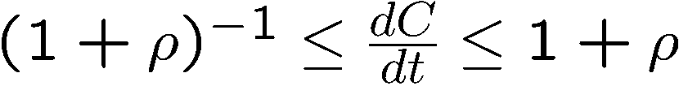
Characteristics & Consequences (v)
Independent physical system clocks with different speeds → clock drift
Mechanisms for balancing of different velocities necessary (clock synchronization)
Accuracy of clock synchronization and resolution of clocks is restricted
Relative location of events in reference to each other is often more important than the exact time of their appearance → Logical clocks
Measured
Time C(t)
exact dC / dt = 1
too fast
dC / dt > 1
„Speed“ of clock
too slow
dC / dt < 1
Reference Time t
A correct clock has a limited maximal drift ρ

Slide 11
Characteristics & Consequences (vi)
Different administrative domains
For each domain, a different administrator is responsible
Centralized administration in large systems impossible
Allow decentralized administration and automating of administration (if possible and secure)
Components are heterogeneous → Heterogeneity
Interoperability between components is difficult to guarantee
Interface standardization

Slide 12
Examples of conceptual problems in distributed systems
Problem of the Two Armies
Distributed make
Phantom-Deadlocks
Slide 12

Slide 13
Problem of the Two Armies
Grey Troops
Blue Troops
Grey Troops
3000
4000
2000
Attack at 6:00 a.m.!
Yes, at 6:00 a.m.!
Arrived?

Slide 14
Distributed make
104
105
106
107
108
109
110
Time according
Computer
to local clock
running compiler
File test.class generated
Computer
102
103
104
105
106
107
108
Time according
running editor
To local clock
File test.java generated
Real Time

Slide 15
Phantom-Deadlocks
A
A
t = 1, observe B
⇒ B waits for A
t = 3, observe A
⇒ A waits for C
B
B
C
C
A
A
Wrong conclusion:
Cyclic waiting graph
→ deadlock
t = 2, observe C
⇒ C waits for B
B
B
C
C

Slide 16
Basic Models for Distributed Systems

Slide 17
Distributed System – An abstract view
A distributed system is a connected graph consisting of a set of nodes and a set of edges
nodes are also denoted as processes, computers etc.
edges are often denoted links, channels etc.
Nodes can exchange messages with their respective direct neighbors over channels
Arbitrary nodes can communicate through routing

Slide 18
Network-Topologies
Default for the lecture
A topology is an undirected graph G = (V, E)
Node set V = {v₀,…,v_{n-1}}
Edge set E = {e₀, …, e_{m-1}}, e_{i} = (v_{i_1},v_{i_2})
Static vs. dynamic topology
Static: node- and edge set do not change
Dynamic: node- and edge set can change over time
Notes:
Undirected -> bidirectional communication

Slide 19
Special Topologies
Ring
Number of nodes = number of edges (n = m)
E = {(v_{i}, v_{j}) | j = (i + 1) mod n}
Node degree (Neighbors per nodes): 2
Node degree constant with scaling
Diameter (longest shortest path) ⌊n / 2⌋
Tree
Connected graph without cycles
m = n - 1

Slide 20
Special Topologies
Star
Special tree with central node v₀
E = {(v₀, v_{i}) | i ≠ 0}
Neighbors per node: 1 or n – 1
Diameter 2
Not (infinitely) scalable
Complete Graph
m = n (n – 1) / 2
E = {(e_{i_1}, e_{i_2}) | i_1 < i_2}
Neighbors per node: n – 1
Diameter 1
Not (infinitely) scalable

Slide 21
Special Topologies
4x4-Mesh
4x4-Torus
Mesh structures
Constant node degree with scaling
Diameter increases with root of node number
Expandable in small increments
Good support of algorithms with local communication structure (e.g., modeling of physical processes)

Slide 22
Special Topologies
Binary Tree
Binary X-Tree
Complete k-nary tree or X-Tree
h = ⌊log_{k} n⌋ (logarithmic height)
Expandable in potencies of k
Constant node degree with scaling
Node degree maximal k + 1 (or maximal k + 3)

Slide 23
Other Topologies (next lecture)
Hyper Cube
Random networks
Small World-networks
Scale-Free Topologies
Notes:
o

Slide 24
Channel Characteristics (from the processes‘ view)
Default for the lecture
Reliability
Reliable: Every sent message arrives once and unchanged
Unreliable: Errors may occur
Loss : Sent message is not received
Duplication: Sent message is received several times
Corruption: Sent message is received corrupted
Adding: A message that was not sent is received
Order
unordered: Messages can overtake each other
FIFO: Messages cannot overtake each other
Notes:
See VS1 for definition of reliable transport
Validity:
any message in the out-bound buffer is eventually delivered to the in-bound buffer
Integrity:
the received message is identical to the one send
No message is delivered twice
Possible question: is TCP reliable or do we need something more ..

Slide 25
Channel Characteristics (from the processes‘ view)
Default for the lecture
Capacity
Unrestricted: An arbitrary number of messages within the channel is possible
Restricted: A maximum of n messages in the channel at the same time
When overflow occurs, either messages are rejected or sender is blocked until there is enough space in the channel
Direction
Bidirectional: Send and receive possible in both directions
Unidirectional: Send and receive only possible in one direction

Slide 26
Channel Characteristics (from the processes‘ view)
Default for the lecture
Synchronous vs. Asynchronous
Asynchronous: The sending of a message is not blocking
Synchronous: The sending of a message is blocking
Sender is blocked until the receiver took the massage; implementation through implicit acknowledgement
Asynchronous
Synchronous
Notes:
See VS1 slides for further discussion (i.e. blocking vs. Unblocking; rendezvous and explicit sync vs. Loose coupling)

Slide 27
Distributed Algorithm
Is executed on the nodes of the system in form of processes
We consider only one process per node
Thus, we often use both terms synonymously
Different parts of the algorithm can run on different nodes
The nodes communicate by exchanging messages over the channels
Notes:
Process = node? What are the communicating entities, questions usually answered by archtiectural model -> see VS for details

Slide 28
Distributed Algorithms
L2: Flooding, Broadcast and Echo (2nd November 2018)
L3: Election Algorithms (9th November 2018)
L4: Mutual Exclusion (16th November 2018)
L5: Clocks (23rd November 2018)
L6: Consistent Snapshots & Snapshot Application (30th November 2018)
L7: Consensus (7th December 2018)
L8: Fault Tolerance (14th December 2018)
L9: Transaction (11th January 2019)
L10: Security (18th January 2019)

Slide 29
State of a Distributed Algorithm
Each node has a local state; it consists of the local variables of the algorithm
The state of a channel consists of the messages in it
The state of a distributed algorithm consists of
the state of the nodes and
the state of the channels

Slide 30
Processing Model
Process
Actions are triggered from outside
Initial action is carried out when starting the algorithm
Then, each process waits passively for the arrival of a message
If a message arrives, a respective atomic action is executed
Messages arriving in the meantime are buffered
An action can change the local state of the process and send messages to other processes
passive
Message
received
Action
executed
active
P₁:
{Init}
SEND(Ping) TO P₂;
P₂: {RECEIVE (Ping) from P₁}
SEND(Pong) TO P₁;

Slide 31
Atom(ic) Model
The Atom Model as the default model for the lecture is a specialization of the asynchronous model
Attention: It is partly synchronized, but not partially synchronous!! -> will be explained later
According to the possible bounds, we can define the synchronicity of a model in terms of
Processors are synchronous or asynchronous
Communication is synchronous or asynchronous
In case of the Atom Model, actions take no time
As a result, a processor cannot execute faster or slower than any other processor
Processors are synchronous
Communication remains asynchronous
Since Communication is asynchronous, the model still behaves like a asynchronous one. So what is the advantage?
Source: Mattern, F. (1987). Algorithms for distributed termination detection. Distributed computing, 2(3), 161-175.

Slide 32
Atom(ic) Model
The Atom Model turns this …
Into this …
Actions are timeless
We only need to count messages when we want to detect termination of a distributed algorithm
P₁
P₂
P₃
P₁
P₂
P₃

Slide 33
Atom(ic) Model
But can we simply consider the processing time as inconsequential for termination ..
No, but we can do this ..
Each process sends a “virtual” message to itself that takes as much time as it would be active
P₁
P₂
P₃
P₁
P₂
P₃

Slide 34
The Problem of Reaching Agreement

Slide 35
The Problem of Reaching Agreement
We know protocols that achieve agreement for specific use cases:
Processes involved in transferring money from one account to another must consistently agree to perform corresponding debit and credit operations
In mutual exclusion, the processes agree on a process that can enter a critical section
Consider an election, the processes agree on which is the elected process

Slide 36
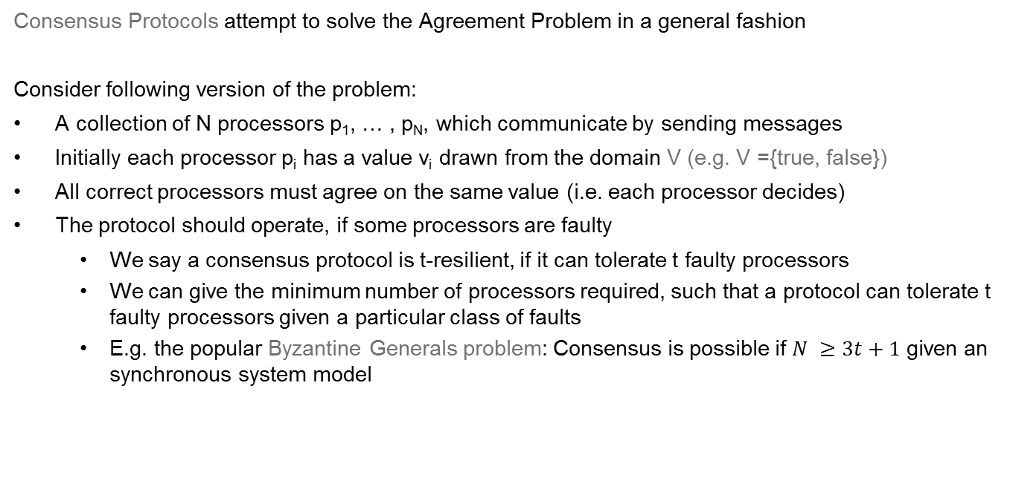
The Problem of Reaching Agreement
Consensus Protocols attempt to solve the Agreement Problem in a general fashion
Consider following version of the problem:
A collection of N processors p₁, … , p_{N}, which communicate by sending messages
Initially each processor p_{i} has a value v_{i} drawn from the domain V (e.g. V ={true, false})
All correct processors must agree on the same value (i.e. each processor decides)
The protocol should operate, if some processors are faulty
We say a consensus protocol is t-resilient, if it can tolerate t faulty processors
We can give the minimum number of processors required, such that a protocol can tolerate t faulty processors given a particular class of faults
E.g. the popular Byzantine Generals problem: Consensus is possible if $N ≥3t+1$ given an synchronous system model

Slide 37
Characteristics of Algorithms
Deterministic vs. Non-deterministic
Deterministic: Always the same trace with the same input
Non-deterministic: Different traces with the same input possible
Determined vs. Not determined
Determined: Always the same result with the same input
Deterministic algorithms are always determined
Non-deterministic algorithms can be determined (e.g. Quicksort with randomly chosen Pivot-element)
Not determined: Different results with the same input possible

Slide 38
Characteristics of Algorithms
Terminating: Terminate for each (valid) input after a limited number of steps
Partially correct: If they terminate, they always deliver a correct result
Totally correct: Terminating and partially correct

Slide 39
Characteristics of Distributed Algorithms
Are (apart from few exceptions) non deterministic. Reasons are, e.g., unpredictable message delay and varying processor speed
Non determinism can be counteracted with synchronization mechanisms
But that decreases the degree of parallelism
There are both determined and not determined distributed algorithms

Slide 40
Characteristics of Distributed Algorithms
Distributed algorithms shall usually be totally correct
But not for every problem to be solved there is a totally correct algorithm
Often, an algorithm with weakened requirements (e.g., with respect to termination) can help
Some algorithms shall not terminate (e.g., continuous clock synchronization)
Then, often the fulfillment of other conditions is required (e.g., of an invariant)

Slide 41
Literature
S. Strogatz. Exploring complex networks. Nature, 410:268--276, 2001.
D. Watts and S. Strogatz. Collective Dynamics of 'Small-World' Networks. Nature, 393:440--442, 1998.
Akkoyunlu, E. A., Ekanadham, K., and Huber, R. V. Some constraints and tradeoffs in the design of network communications. In Proceedings of the Fifth ACM Symposium on Operating Systems Principles. ACM, New York, NY, 67-74, 1975.

